Slide 1
PUSH UP

Slide 2
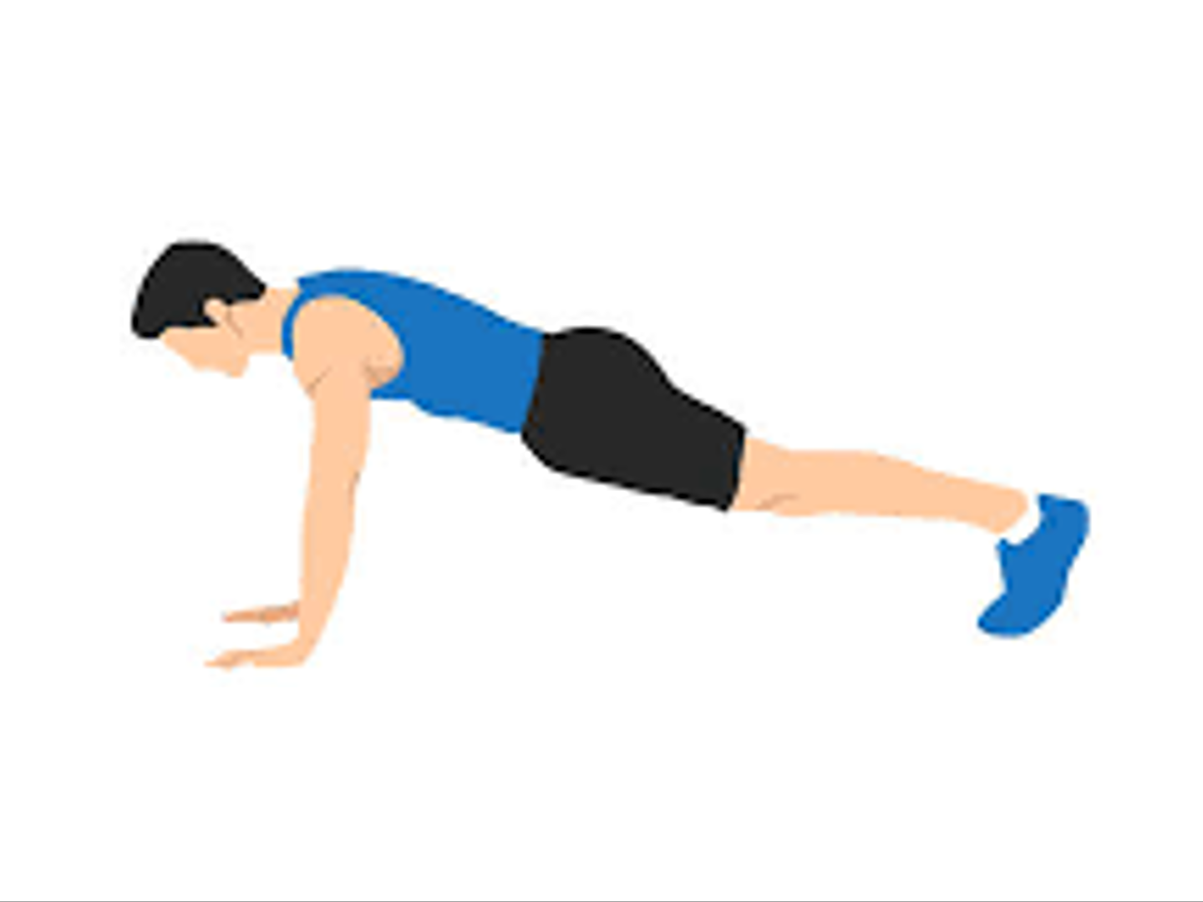
PUSH UP
POSE 1
177.73 °
right_hip_angles
171.15 °
175.49 °
right_elbow_angles
right_knee_angles

Slide 3
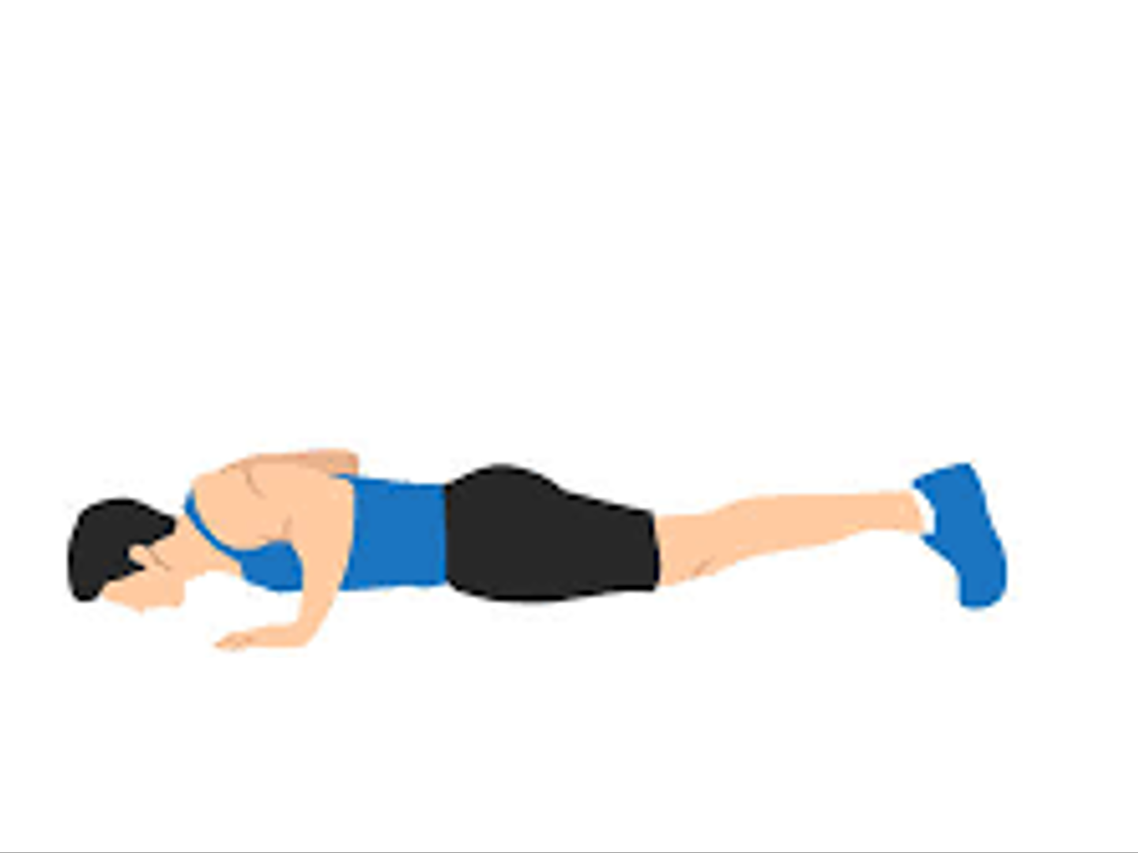
PUSH UP
POSE 2
178.49 °
right_hip_angles
66.29 °
176.49 °
right_elbow_angles
right_knee_angles

Slide 4
PUSH UP
POSE 3
177.73 °
right_hip_angles
171.15 °
175.49 °
right_elbow_angles
right_knee_angles

Slide 5
BIRD DOG

Slide 6
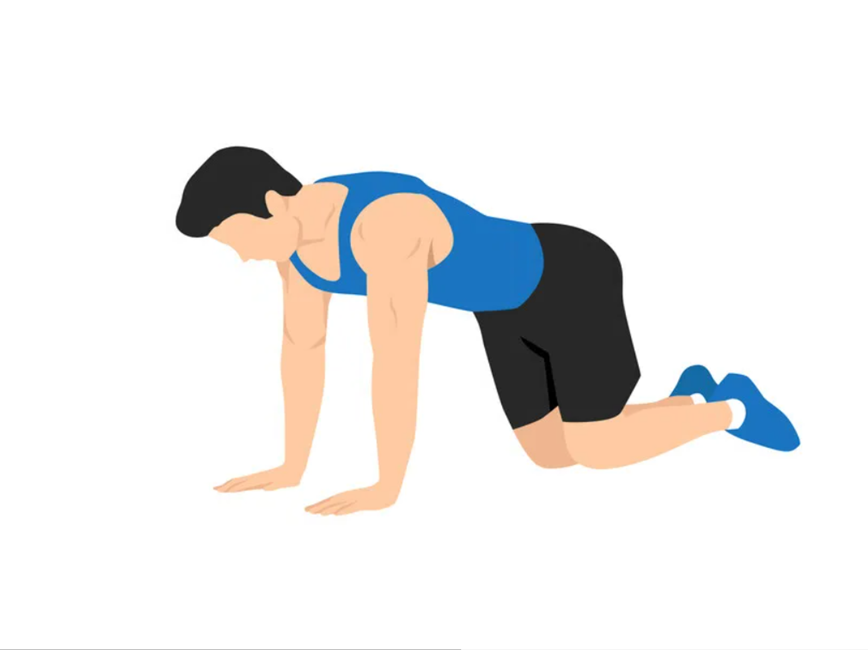
BIRD DOG
POSE 1
72.49 °
right_shoulder_angles
105.37 °
right_hip_angles
63.62 °
165.97 °
left_knee_angles
right_elbow_angles
170.38 °
61.68 °
left_elbow_angles
right_knee_angles

Slide 7
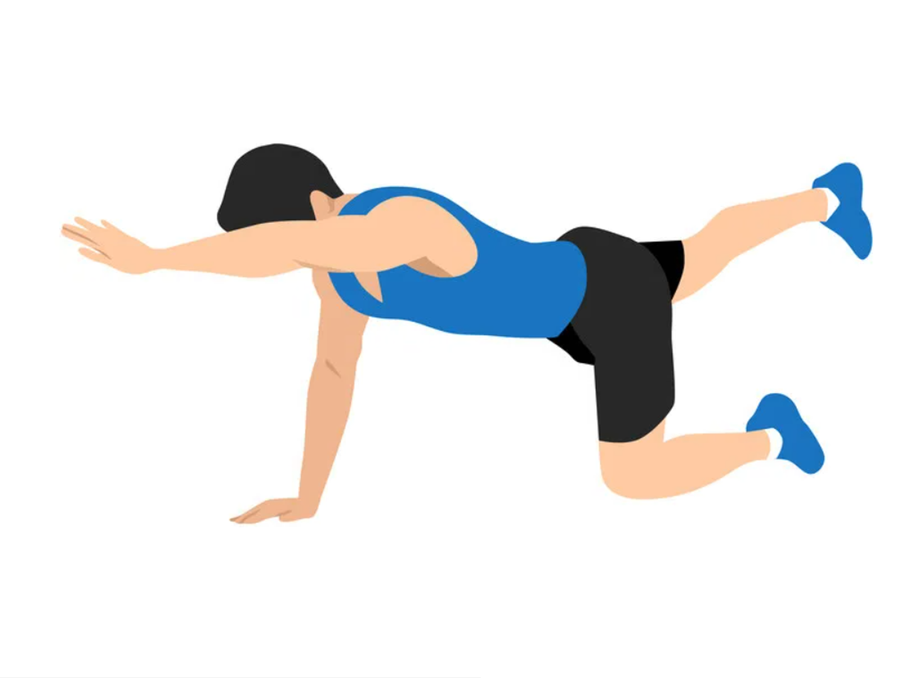
BIRD DOG
POSE 2
129.69 °
right_shoulder_angles
98.71 °
right_hip_angles
164.86 °
158.01 °
left_knee_angles
right_elbow_angles
174.23 °
67.69 °
left_elbow_angles
right_knee_angles

Slide 8
BIRD DOG
POSE 3
72.49 °
right_shoulder_angles
105.37 °
right_hip_angles
63.62 °
165.97 °
left_knee_angles
right_elbow_angles
170.38 °
61.68 °
left_elbow_angles
right_knee_angles

Slide 9
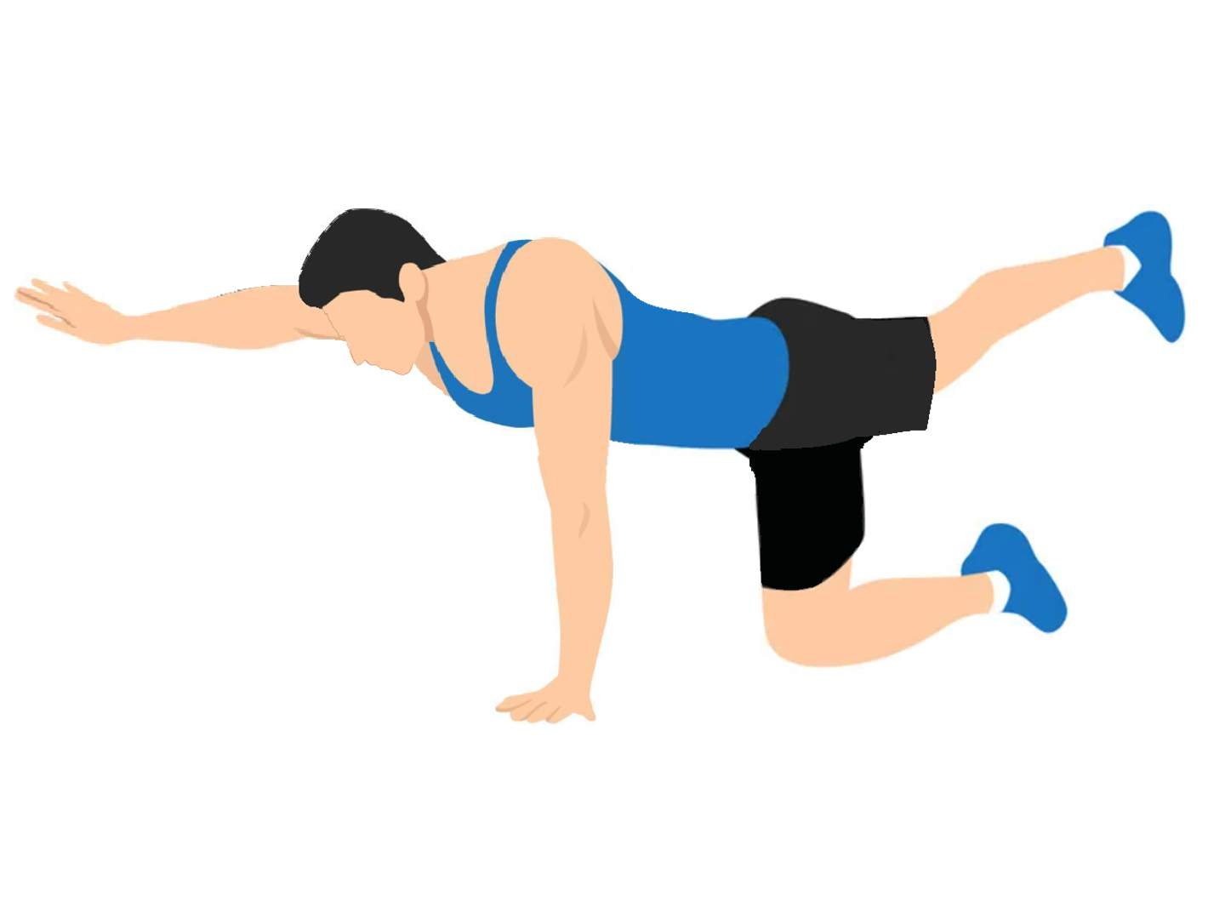
BIRD DOG
POSE 4
80.95 °
right_shoulder_angles
169.19 °
right_hip_angles
60.73 °
168.49 °
left_knee_angles
right_elbow_angles
167.78 °
165.81 °
left_elbow_angles
right_knee_angles

Slide 10
BIRD DOG
POSE 5
72.49 °
right_shoulder_angles
105.37 °
right_hip_angles
63.62 °
165.97 °
left_knee_angles
right_elbow_angles
170.38 °
61.68 °
left_elbow_angles
right_knee_angles

Slide 11
CURL UP

Slide 12
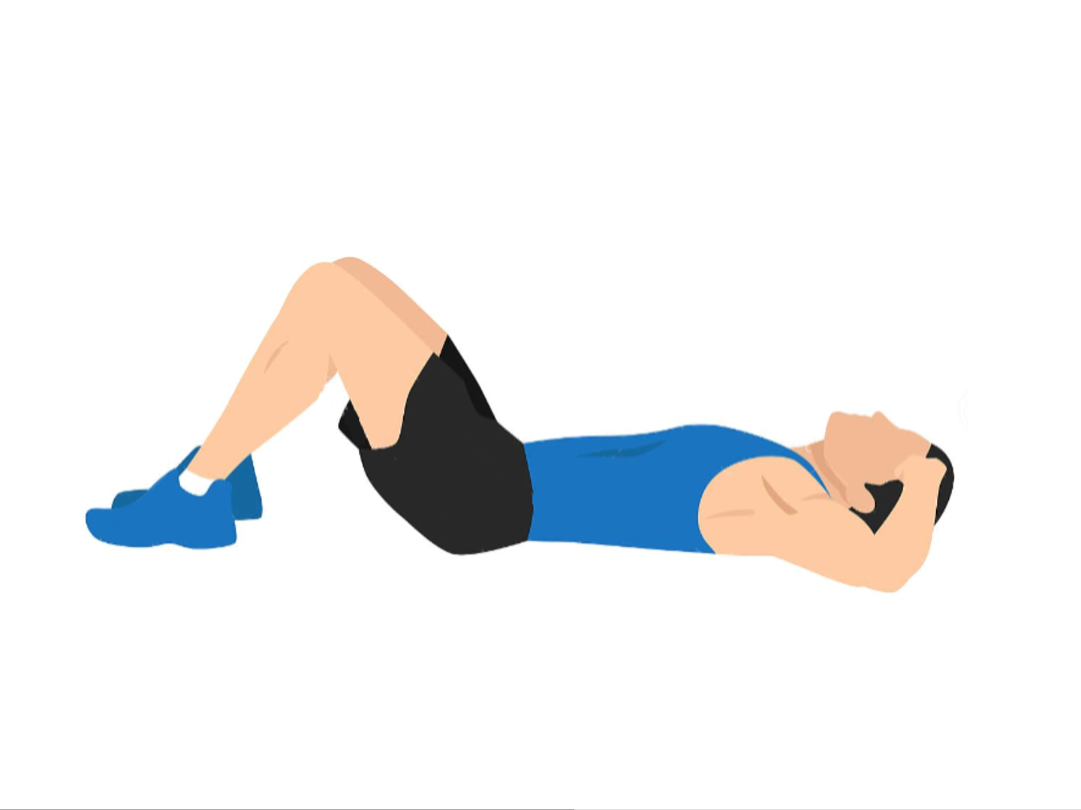
CURL UP
POSE 1
133.67 °
right_hip_angles
76.96 °
30.81 °
right_knee_angles
right_shoulder_angles

Slide 13
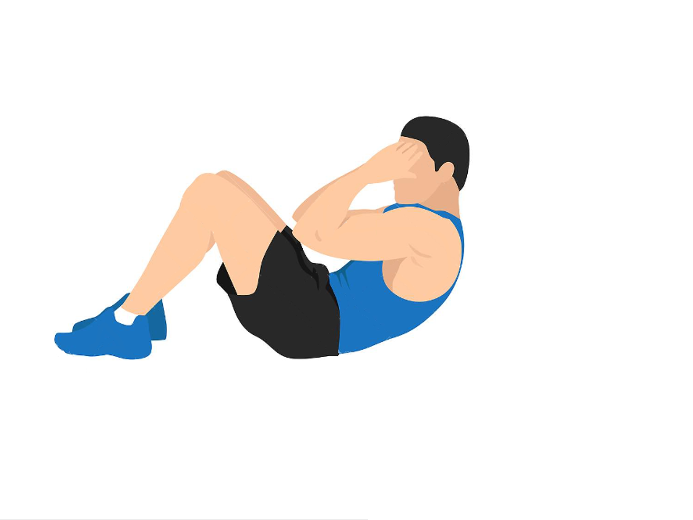
CURL UP
POSE 2
111.06 °
right_hip_angles
82.99 °
27.32 °
right_knee_angles
right_shoulder_angles

Slide 14
CURL UP
POSE 3
133.67 °
right_hip_angles
76.96 °
30.81 °
right_knee_angles
right_shoulder_angles

Slide 15
FORWARD LUNGE

Slide 16
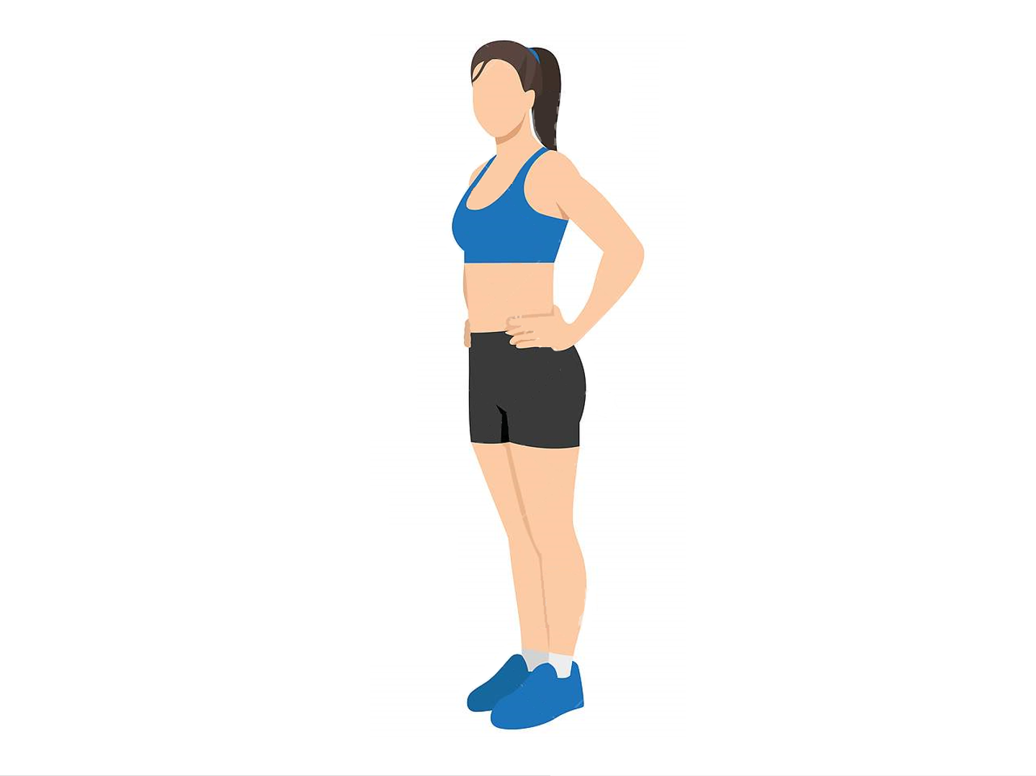
FORWARD LUNGE
POSE 1
175.10 °
right_hip_angles
171.96 °
166.34 °
left_knee_angles
right_knee_angles

Slide 17
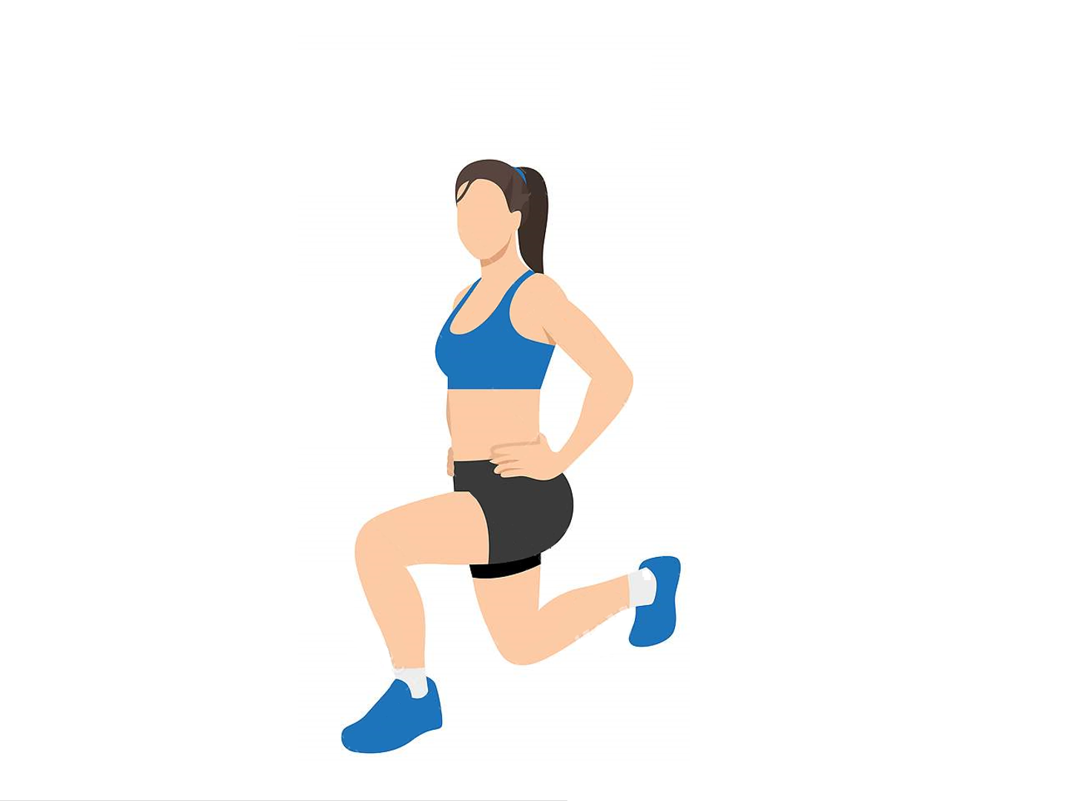
FORWARD LUNGE
POSE 2
176.06 °
right_hip_angles
77.33 °
90.95 °
left_knee_angles
right_knee_angles

Slide 18
FORWARD LUNGE
POSE 3
175.10 °
right_hip_angles
171.96 °
166.34 °
left_knee_angles
right_knee_angles

Slide 19
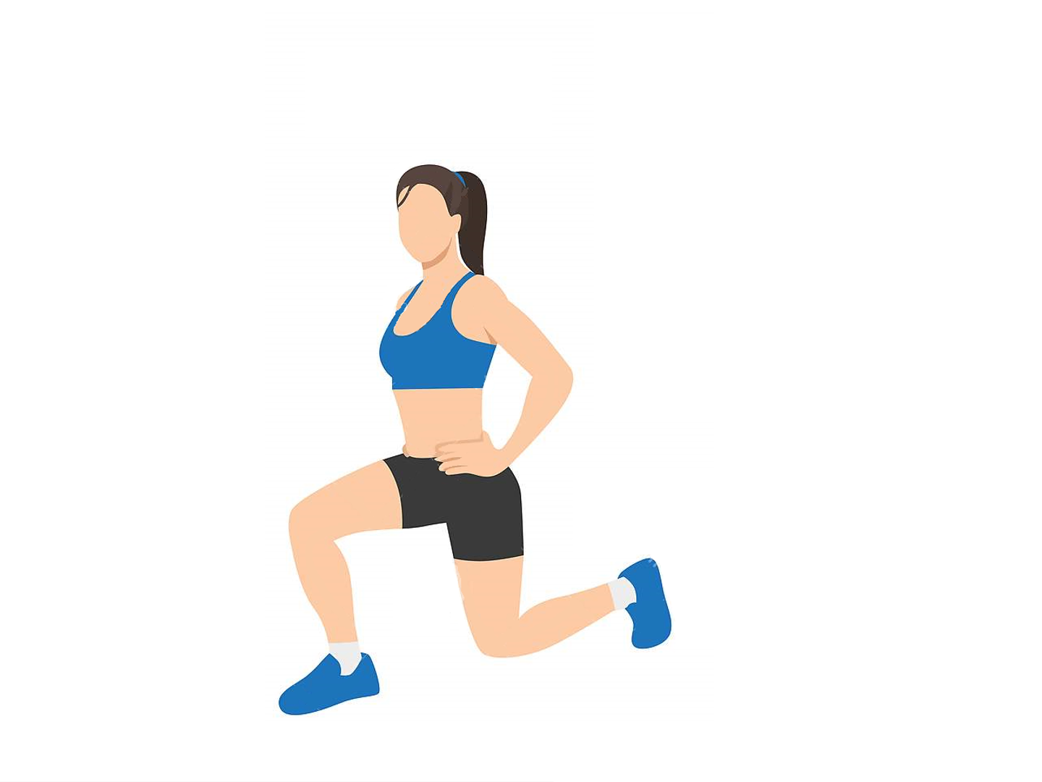
FORWARD LUNGE
POSE 4
91.18 °
right_hip_angles
91.40 °
71.49 °
left_knee_angles
right_knee_angles

Slide 20
FORWARD LUNGE
POSE 5
175.10 °
right_hip_angles
171.96 °
166.34 °
left_knee_angles
right_knee_angles

Slide 21
FRONT PLANK

Slide 22
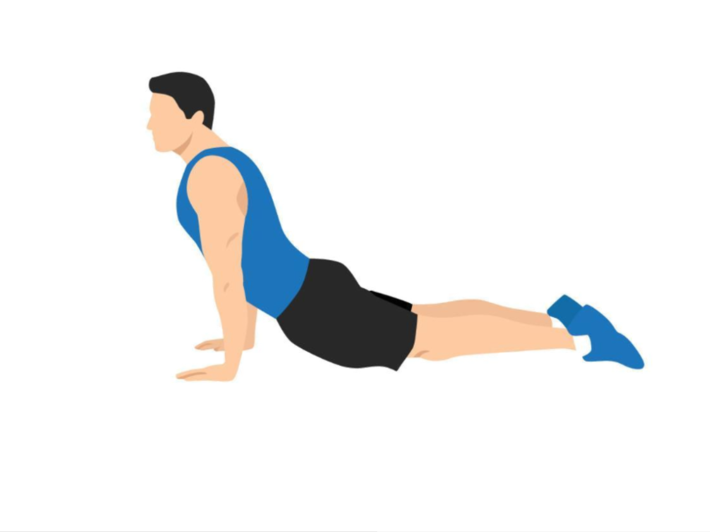
FRONT PLANK
POSE 1
56.12 °
right_shoulder_angles
157.37 °
150.71 °
right_hip_angles
right_ankle_angles

Slide 23
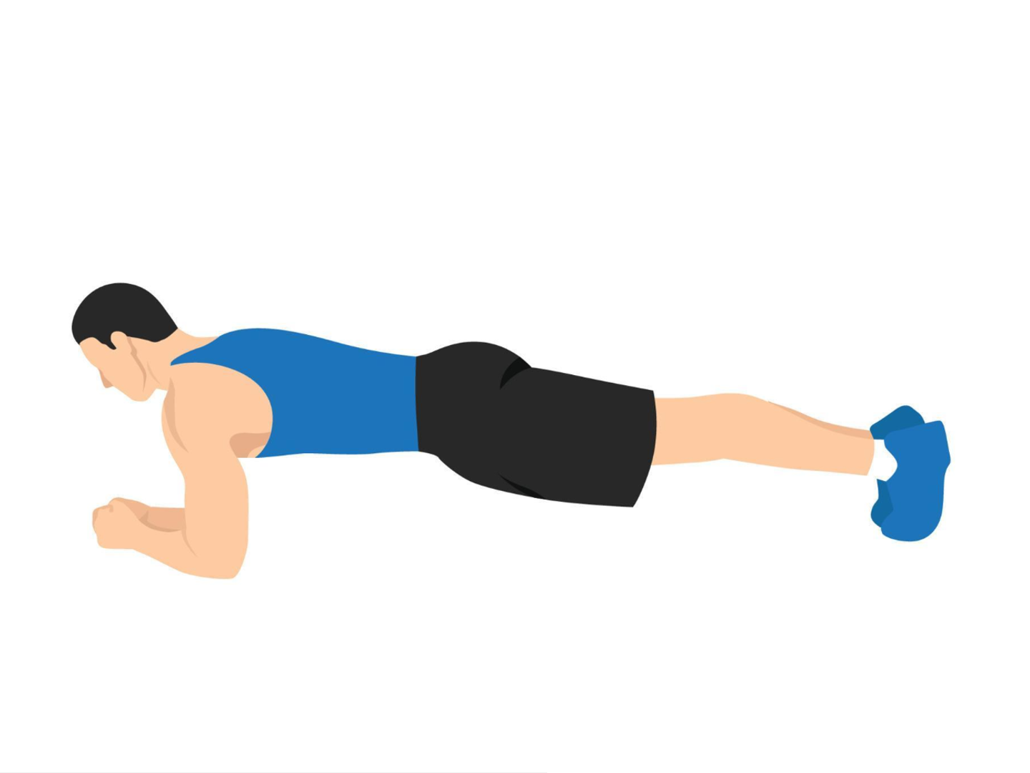
FRONT PLANK
POSE 2
89.29 °
right_shoulder_angles
165.80 °
88.57 °
right_hip_angles
right_ankle_angles

Slide 24
FRONT PLANK
POSE 3
56.12 °
right_shoulder_angles
157.37 °
150.71 °
right_hip_angles
right_ankle_angles

